Slide 1
Permitting Fit-for-Purpose Treatment and Reuse of Produced Water
Summary of Current and Emerging State Discharge Regulations
Mike Hightower
New Mexico Produced Water Consortium
Hope Dalton
Colorado Produced Water consortium
Shane Walker
Texas Produced Water consortium
Loren Anderson
Marcellus Shale Coalition
March 12, 2024

Slide 2
Presentation Overview
Review of EPA’s National Water Reuse Action Plan efforts for produced water.
Short overview of produced water -
  variations in quality, federal guidelines and directions
Information on regional produced water treatment drivers and current and emerging state discharge regulations.
Audience discussion of regulatory and economic drivers and trends in fit-for-purpose treatment, recycling, and reuse of produced water.

Slide 3
2020 EPA National Water Reuse Action Plan
Focus on the fit-for-purpose treatment and reuse of waste water
Five major programmatic areas:
  Thermo-electric cooling water
  Agricultural waste water
  Municipal waste water
  Produced water
  Storm water
Produced water milestones in Section 2.4.2 of the WRAP include collaboration and outreach with WRA and industry
Two of the United Nations’ Sustainable Development Goals are water reuse as key to a more sustainable future.
3

Slide 4
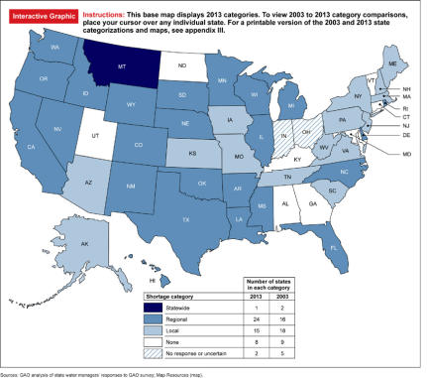
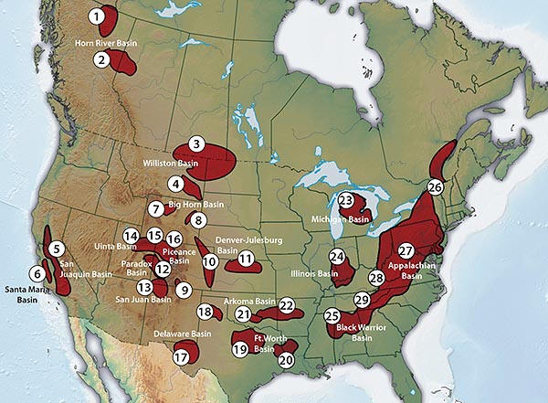
Why Consider Treating and Reusing Produced Water
State Water Stress
Unconventional Oil and Gas Basins
4

Slide 5
Public Support for Fit-for-Purpose Treatment and Reuse of Produced Water?
Identify all potential reuse applications that you would support for the use of treated produced water to conserve the use of New Mexico’s freshwater supplies, if the water is treated and regulated to standards that prove it to be safe to use and protect human health and the environment?
Uses inside the oil field - such as construction, drilling and fracking, concrete mixing, and dust suppression (61%)
Industrial uses outside the oil field - such as construction, power generation, manufacturing, etc. (61%)
Agricultural uses, such as irrigation for non-edible crops (e.g., cotton) (65%)
Multiple agricultural uses, e.g., irrigation, rangeland restoration, livestock watering, etc. (53%)
Supplemental drinking water supplies (41%)
I need more information to support the reuse of treated produced water (25%)
No, I would not support the reuse of treated produced water for any use outside of the oil field (5%)
2022 and 2023 Combined NMPWRC Survey Results
5
5

Slide 6
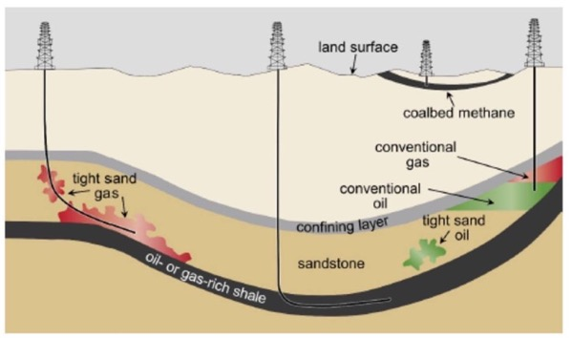
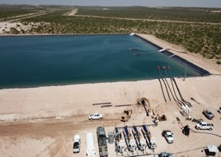
Produced Water - a by-product of Oil and Gas Production
Water can be 0.5-50 times the volume of oil produced.
Produced water can contain high levels of minerals and organic compounds from geology and hydrocarbon contact plus drilling and completion chemicals.
Quality varies by location, formation, and type of well.
Not a designated hazardous waste
6

Slide 7
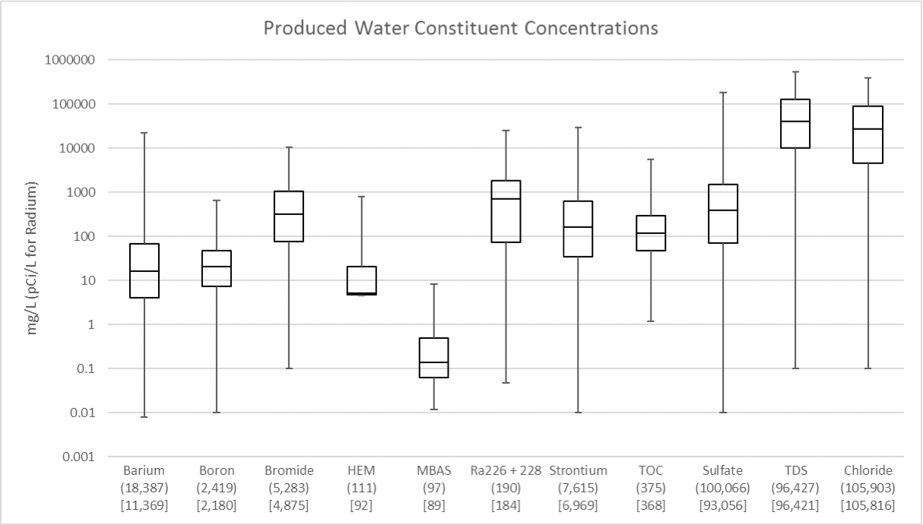
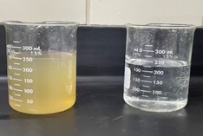
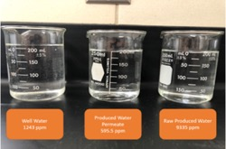
Produced Water Quality – Treatment Often Needed for Reuse
Permian Basin
Permian Basin
[EPA-821-S19-001]
San Juan Basin
7

Slide 8
Federal Guidelines for Produced Water Treatment and Reuse
Ref: Oil and Natural Gas Produced Water Governance in New Mexico – Draft White Paper November 2018
8

Slide 9
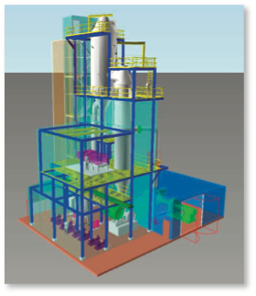
Federal Guidelines on Produced Water
40 CFR 435 Subpart C– Oil and Gas Extraction Point Source Category
  Produced water is defined as “the water brought up from the hydrocarbon-bearing strata during the extraction of oil and gas, and can include formation water, injection water, and any chemicals added downhole or during oil/water separation process”
  Unconventional produced water prohibited through a POTW
  Zero discharge of produced water unless sent to a centralized water treatment (CWT) facility, except west of the 98th Meridian
Schematic of a
Pennsylvania CWT Plant
9

Slide 10
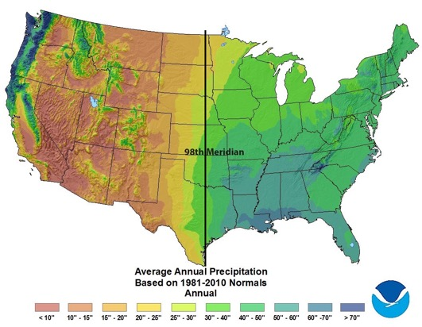
Produced Water Treatment and Reuse for Discharge
40 CFR 435 (Subpart E) – On shore facilities west of the 98th Meridian can discharge produced water if it has a use in agriculture or wildlife propagation when discharged to waters of the U.S.
40 CFR 435.51(c) “can be used if produced water is of good enough quality for wildlife or livestock water or other agricultural uses and is actually put to such use during periods of discharge”
40 CFR 435.52(b)
  Max oil and grease – 35 mg/l
10

Slide 11
Oily Waste Discharge Regulations Not Used for Produced Water
.
40 CFR 437 Subpart B – Oily Waste Water Treatment and Reuse
  Minimum requirements in mg/L
Per EPA, these regulatory values considered for industrial waste water rather than for treatment and discharge of produced water
Produced water often has ~100 major constituents –
  high salts, high oils and grease, radionuclides, high TPH, etc. not addressed in this regulation
Regulated parameter | Maximum daily¹ | Maximum monthly avg.¹
Conventional Parameters
O&G | 127 | 38.0
pH | (²) | (²)
TSS | 74.1 | 30.6
Metal Parameters
Arsenic | 2.95 | 1.33
Cadmium | 0.0172 | 0.0102
Chromium | 0.746 | 0.323
Cobalt | 56.4 | 18.8
Copper | 0.500 | 0.242
Lead | 0.350 | 0.160
Mercury | 0.0172 | 0.00647
Tin | 0.335 | 0.165
Zinc | 8.26 | 4.50
Organic Parameters
Bis(2-ethylhexyl) phthalate | 0.215 | 0.101
Butylbenzyl phthalate | 0.188 | 0.0887
Carbazole | 0.598 | 0.276
n-Decane | 0.948 | 0.437
Fluoranthene | 0.0537 | 0.0268
n-Octadecane | 0.589 | 0.302
MORE STRINGENT STATE DISCHARGE REG’s
11

Slide 12
Overview of Current Eastern and Western U.S. Produced Water Recycling and Reuse Regulations
Recycling – use inside oil and gas
Reuse – use outside oil and gas
Eastern State Example
  Pennsylvania
Western State Examples
  Texas
  New Mexico
  Colorado
  California
  Wyoming

Slide 13
  Produced Water Treatment and Reuse in Pennsylvania
Example Time Period Examined: January 2019 – January 2020 (13 months)
  From PA DEP Oil and Gas Waste Reporting Website for unconventional PA Operators (Marcellus/Utica)
Produced Water Recycling
  The majority of produced water from unconventional wells in PA is pre-treated and recycled for the next well. Most operators store water in above ground containment facilities. Impoundments are banned in PA.
Injection Wells
  Only 7 commercial disposal wells in PA. Some PW shipped to Ohio and West Virginia.
Produced Water Treatment and Reuse
  Discharge, disposal and road spreading of produced water prohibited. POTWs are not permitted to treat water. Only PADEP approved CWT facilities may treat and discharge. Must meet drinking water standards prior to discharge. Few exist.
13

Slide 14
  Produced Water Recycling and Reuse in Pennsylvania
Key Takeaways
  January 2019 – January 2020*
  73,815,044 barrels of wastewater reported by PA Operators
    68,649,013 barrels recycled or treated for reuse (93%)
    5,166,031 barrels disposed in injection wells (7%)

Slide 15
Federal Guidance on Produced Water Treatment for Land and Ag Discharge
Parameter | Units | Irrigation Water Class 1 Class 2 Class 3
Total Dissolved Solids | mg/L | <700 | <2000 | >2000
Sodium | mg/L | 400 | 1000 | >1500
Boron | mg/L | <0.5 | <2 | >2
Other important irrigation/land application parameters:
  total organics, ammonia, sodium adsorption ratio (SAR), chlorides, NORM, metals
For most soils, Class 3 waters are not recommended
Most produced waters will require treatment and desalination to meet state ag, land, or surface water discharge standards
BOR Report 157, 2011
15

Slide 16
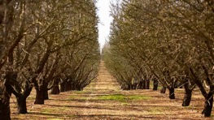
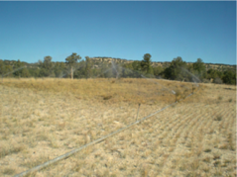
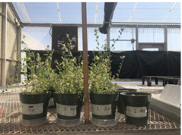
Current Western States Treated Produced Water
Land and Agriculture Regulations for TX, CA, and WY
State | TDS mg/L | Total Constituents Evaluated | Date Developed | Application
California* | 1000 | ~100 | 1995 | Full-scale irrigation
Wyoming | 500 | ~100 | 2020 | Full-scale rangeland
Texas RRC | 1000 | ~50 | 2024 | Pilot-scale rangeland or irrigation
* Conventional produced water only
16

Slide 17
Texas Treated Produced Water
Surface Water Discharge Guidelines
Current surface discharge standards based on national EPA CWA water quality criteria.
Testing and analysis shows treated produced water can meet existing surface water discharge criteria.
Pecos is not a drinking water supply source, but has local ecological benefits
Companies pursuing NPDES permits with TCEQ
Pecos River Discharge Criteria
New Mexico - At the TX State Line
41 aquatic impact constituents
110 - human impact constituents
Water quality – 3600 ppm TDS
Texas - Below NM State Line
45 aquatic impact constituents
110 – human impact constituents
Water quality – 4000 ppm TDS

Slide 18
Produced Water Recycling in Colorado
Goal: To reduce the use of freshwater and increase the recycling of produced water in oil and gas operations.
March 2024 – Deliver to General Assembly a review of guidance documents and case studies of best practices for infield reuse and recycling of produced water.
December 2024 - provide recommendations to Energy and Carbon Management Commission for new rules to require statewide reduction in fresh water use and increase in use of produced water in oil and gas operations.
Toxicological method evaluation (2025).
18

Slide 19
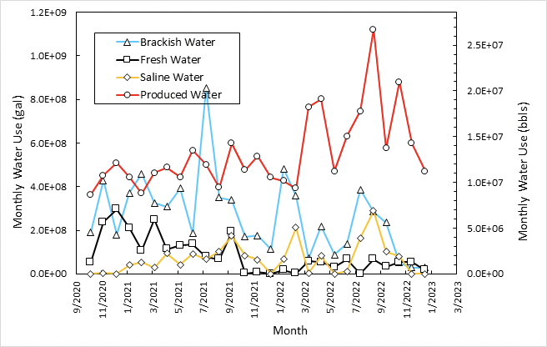
Affect of Produced Water Recycling Regulations on Fresh Water Use
Current Water Use in
Drilling and Fracking
State | Fresh Water Use | Produced Water Reuse
New* Mexico | 5% | 80%
Texas | 50% | 50%
* Fresh water use regulation
change in 2019, more restrictions
proposed in 2024
19

Slide 20
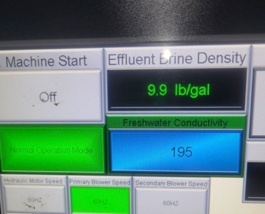
Produced Water Treatment and Recycling in New Mexico
More recycling inside oil and gas
  Treatment and reuse of produced water in plugging and abandoning orphan wells
  Similar use in repurposing abandoned oil and gas wells for brackish water wells
  Get more oil recovery and lower SWD operational costs with ‘clean brine’
Brine
Recovery
Distillate
NMPWRC Thermal Technology Testing
Produced water thermal treatment - fresh water for cementing and 10# brine for re-drilling before cementing
$2/bbl for fresh water and $3/bbl for 10# brine
$25 M in federal funding
PW
Clean
brine
20

Slide 21
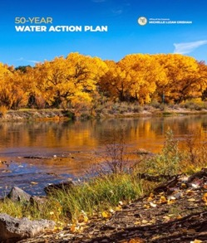

Produced Water Treatment and Reuse in New Mexico
Preserve and increase fresh water supplies by treating produced water for uses outside oil and gas as part of NM WATER ACTION PLAN
May 2024 – Submit draft guidance to Water Quality Control Commission for treatment and reuse of produced water for industrial uses having no discharge – greenhouses, hydrogen production, industrial cooling water, semiconductor manufacturing, etc.
November 2024 – Additional submittal to Water Quality Control Commission for treatment and reuse of for additional applications.
21

Slide 22
Mike Hightower NM Produced Water Research Consortium mmhightower@q.com 505-859-1563 | Karl Longley CA Central Valley Water Quality Control Commission karll@mail.fresnostate.edu
Hope Dalton CO Produced Water Consortium hope.dalton@state.co.us 720-435-9302 | Loren Anderson Marcellus Shale Coalition landerson@marcelluscoalition.org
Shane Walker TX Produced Water Consortium Shane.Walker@ttu.edu
22
22

