Slide 1
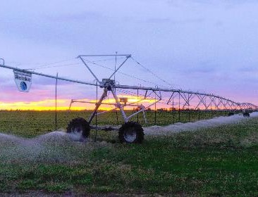
One Water and Produced Water Reuse
Rocky mountain AWWA
Albuquerque – April 4-5, 2024
Mike Hightower, NMPWRC
Jerri Pohl, NM OSE

Slide 2
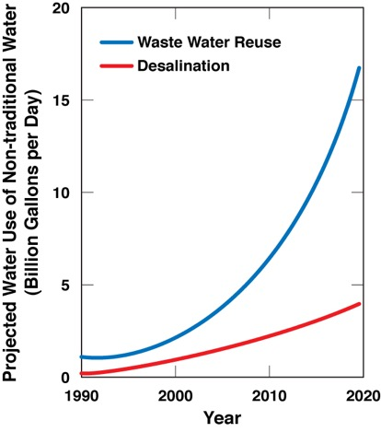
Treatment vs. Fresh Cost and Use Trends
>70,000 ppm TDS -Thermal
Reuse – 15%/yr growth
Desal – 10%/yr growth
35,000 ppm TDS -SWRO
3500 ppm TDS
3,500 ppm TDS
BWRO
(EWRI Hightower 2018)
Notes:
I would like to see a graph that leaves out the 300,000 scenario. Its not relevant here and confuses the issue.

Slide 3
Energy and Technology Drives the 'One Water’ Concept
Water Supply Options | Energy Demand (kWhr/kgal)
Fresh Water Importation (100-300 miles) | 10-18
Seawater Desalination w/Reverse Osmosis | 12-20
Brackish Groundwater Desalination Reverse Osmosis Treatment Pumping and concentrate management Total | 7-9 1-3 8-12
Aquifer Storage and Recovery Pre-treatment (as needed) Post-treatment (as needed) Pumping Total | 3-4 3-4 2-3 5-11
3

Slide 4
Global “One Water” Concept
“One Water” is a concept that all water has “Value” including waste water if treated for appropriate use
Two of the United Nations’ Sustainable Development Goals identify water reuse as key to a more sustainable economic and ecological future.
EPA focus is on waste water treatment for fit-for-purpose reuse
EPA Focus includes industrial, municipal, agricultural, oil and gas and electric power, and storm water treatment and reuse
2021 World Water Development Report
US EPA 2020
4

Slide 5
Water Availability is a Key Global Economic Driver
NM ranks 49th in fresh
water availability
US economic, energy, and water growth
AZ NM
Water supply: 7 M acft/yr 2 M acft/yr
GDP: $300 B/yr $100 B/yr
Ag use: ~72% ~78%
M&I use: ~28% ~22%
Population: 7 M 2 M
Water for agriculture
Water for manufacturing
Water for energy
Water for domestic needs
Water for recreation
“Water promises to be to the 21st century what oil was to the 20th century: the precious commodity that determines the wealth of nations.”
Fortune Magazine, May 15, 2000
5

Slide 6
Surface Water Challenge – Mid-latitude Climate Cycle Impacts
U of A Tree Ring Data
NM 50-year water plan - climate analysis shows NM cannot continue to operate under current water planning and stewardship approaches
6

Slide 7
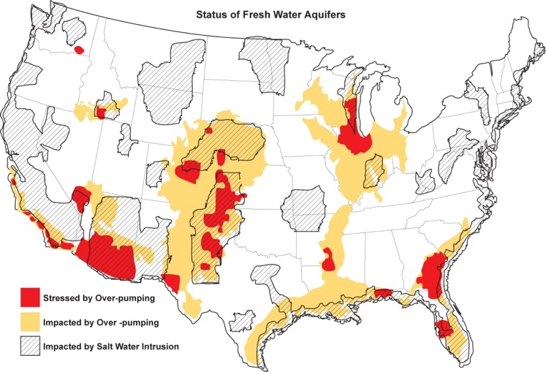
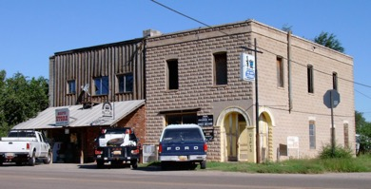
U.S. Ground Water Stewardship – Towns are Dying
NM Example
Hope, New Mexico 88540,
1920 population – 2100
20 sq. miles of orchards
2020 Population - 100
(Shannon 2007)
7

Slide 8
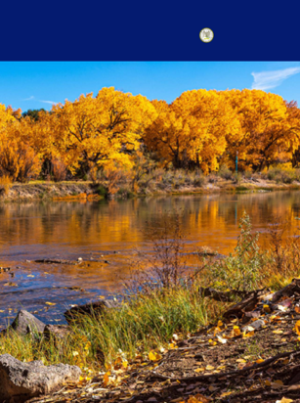
50-YEAR
Office of the Governor
MICHELLE LUJAN GRISHAM
WATER ACTION PLAN
OSE Water Policy and Infrastructure Task Force - December 2022
“…need to augment supply regionally, through such tools as brackish groundwater desalination, wastewater reuse, and treated or recycled produced water. “
8

Slide 9
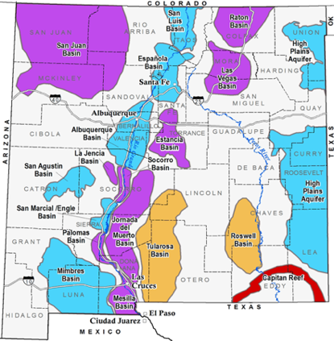
Why Use Brackish Ground Water – >2 billion ac ft in NM
The 1983 La Paz Agreement between the United States and Mexico is a pact to protect, conserve, and improve the environment of the border region of both countries.
Overview of Fresh and Brackish Water Quality in New Mexico.
New Mexico Bureau of Geology and Mineral Resources, OFR-583, New Mexico Tech, Socorro, NM, June 2016.
9

Slide 10
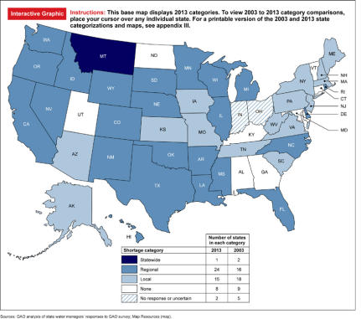
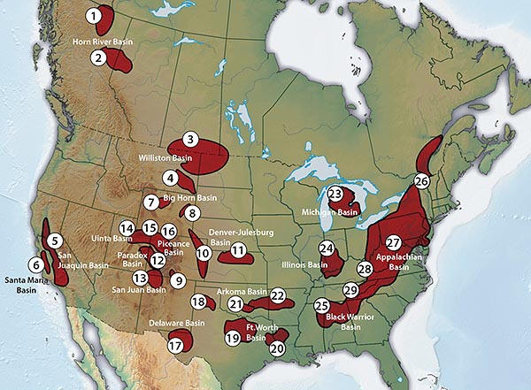
EPA Interest in Produced Water – Huge Opportunities Nationally
6
10

Slide 11
OSE Interest in Produced Water – Huge Opportunities in NM
Protects 50% of NM state revenues
150,000 - 200,000 ac ft of ‘new’ water
O&G is the only ‘water positive’ industry
~30K TDS
~1,500 TDS
250,000 AF
~100K TDS
NMWRRI - 2020
11

Slide 12
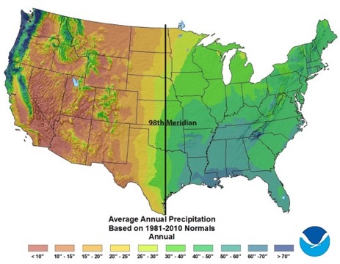
Federal Regulations Allow Produced Water Use In the West
Current Ag Discharge Criteria
NM - 20-25 Constituents
CO, WY, OK, CA, BoR– 30-40 Constituents
Generally 1000 ppm TDS
Current Pecos River Discharge Criteria
NM – 41 aquatic impact constituents
110 - human impact constituents
Artesia target quality – 2600 ppm TDS
State line target quality – 3600 ppm TDS
TX – 45 aquatic impact constituents
110 – human impact constituents
Red Bluff target quality – 4000 ppm TDS
Produced water reuse allowed if quality is such that it can be used via surface water discharge for irrigation
“Seize the Opportunities”
12

Slide 13
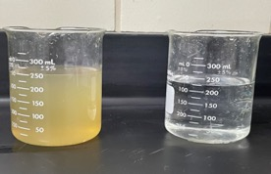
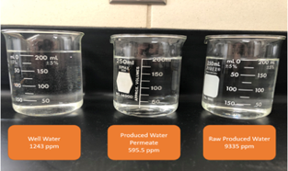
Common Treatment Train Approach for Safe Water
Permian Basin -100,000 TDS Raw PW (left) pre-treatment (right)
Permian Basin -100,000 TDS Raw PW (left) pre-treatment (center)
San Juan Basin -10,000 TDS Raw PW (right) w/RO treatment (center)
9
13

Slide 14
Quality of Thermal Treatment of Permian Produced Water
Constituent | Feed (ppm) | Distillate (ppm)
TDS | 126,000 | 350 +/-150
TPH | 75 +/-70 | 11 +/-3
Ammonia | ~400 | 46
Fe | 1 | 0
Mn | 0.36 | 0.004
Na | 38162 | 102
Ca | 4554 | 7
Mg | 751 | 1.5
K | 647 | 0.9
Ba | 6.6 | 0.9
Constituent | Feed (ppm) | Distillate (ppm)
Sr | 1348 | 3.3
Al | 0,14 | 0.006
Li | 32 | 0.005
Zn | 0.04 | 0.02
Pb | 0 | 0.006
HCO3 | 120 | 200
SO4 | 270 | 10
Cl | 72300 | 160
Si | 17 | 0.10
PO4 | 3.7 | 2.90
Average of a example real-time hourly data during a one-month test series
14

Slide 15
Public Acceptance of Produced Water Treatment and Reuse
Identify all potential reuse applications that you would support for the use of treated produced water to conserve the use of New Mexico’s freshwater supplies, if the water is treated and regulated to standards that prove it to be safe to use and protect human health and the environment?
Uses inside the oil field - such as construction, drilling and fracking, concrete mixing, and dust suppression (61%)
Industrial uses outside the oil field - such as construction, power generation, manufacturing, etc. (61%)
Agricultural uses, such as irrigation for non-edible crops (e.g., cotton) (65%)
Multiple agricultural uses, e.g., irrigation, rangeland restoration, livestock watering, etc. (53%)
Supplemental drinking water supplies (41%)
I need more information to support the reuse of treated produced water (25%)
No, I would not support the reuse of treated produced water for any use outside of the oil field (5%)
15

