Slide 1




Produced Water Recycling and Reuse
The Role in Western Water Stewardship
Mike Hightower, Director
New Mexico Produced Water
Research Consortium
mmhightower@q.com, 505-859-1563
OIL FIELD WATER MANAGEMENT SYMPOSIUM
MARCH 27-28, 2024

Slide 2

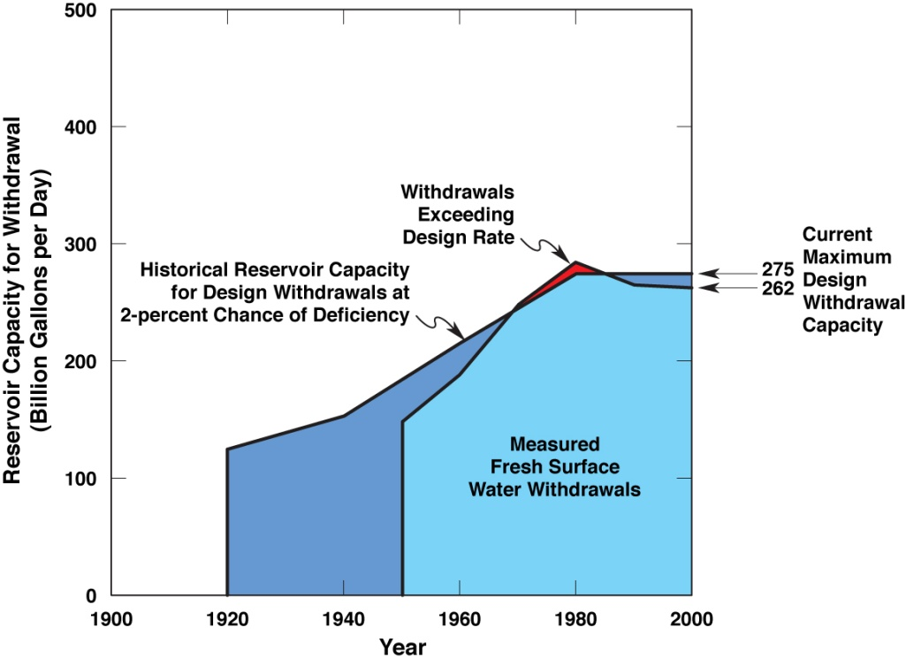
Current U.S. Fresh Surface Water Stewardship
Water Sustainability
  “support as just”
  acknowledged by society
Water Stewardship
  “actively direct and manage”
  personal/professional/societal commitment
USGS Fresh Surface Water Withdrawals
2

Slide 3
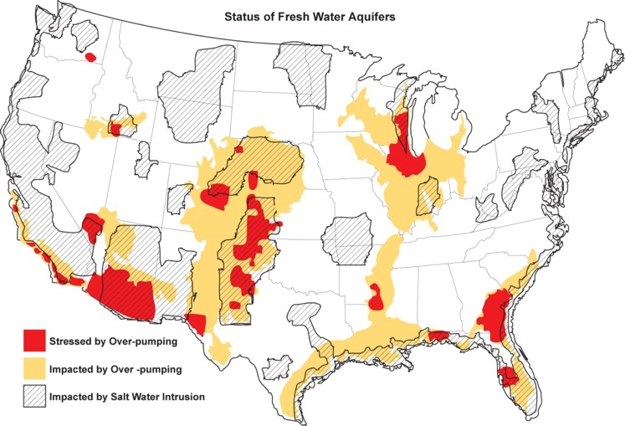
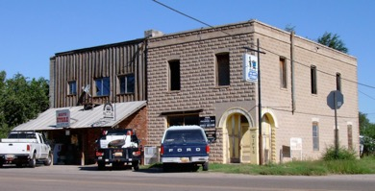
Current U.S. Ground Water Stewardship
Hope, NM - 95% Population decrease
due to loss of ground water supply
Communities are at risk of running out of water
3

Slide 4
Long-term Western Water Stewardship Challenges
Univ. of Arizona – Tree Ring Lab – SW 50 year averages
Climate Impact on Rainfall
  Enhanced evapotranspiration
  50% less surface water runoff
  More reliance on groundwater
Ecological/Environmental Impact
  Aridification in the west
  Less environmental flows
  Reduction in agriculture
Economic/Social Impact
  Community abandonment, population migration
4

Slide 5
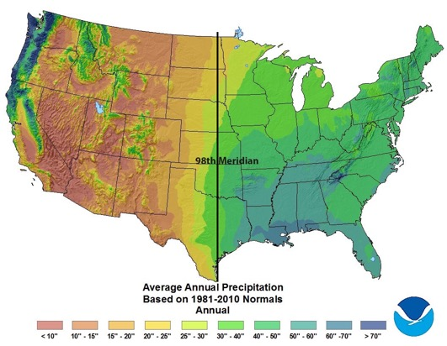
Changing Climate Impacts on Water and Associated Ecological and Agricultural Impacts
USDA announces in 2924 the the 98th Meridian has moved 145 miles east
- Really means dry-land farming has moved east 145 miles
5

Slide 6
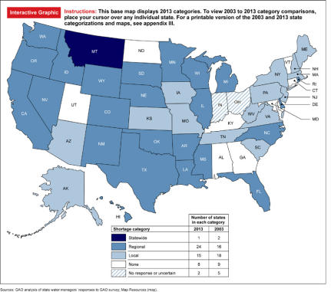
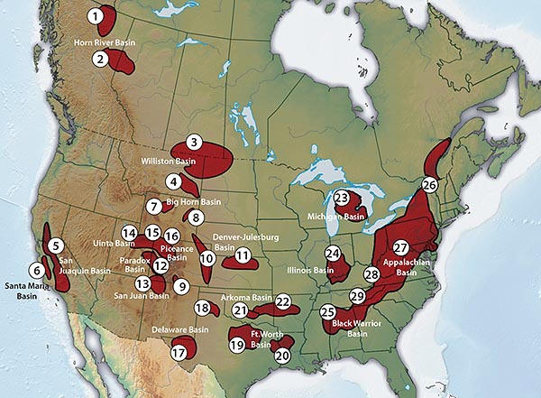
Why Consider Treating and Using Produced Water
State Water Stress
Unconventional Oil and Gas Basins
6

Slide 7
National Produced Water Reuse Program
Focus is on the fit-for-purpose treatment and reuse of waste water – including produced water
..”examples of reuse applications include; agriculture and irrigation, potable and non-potable water supplies, groundwater storage and recharge, industrial processes, on-site non-potable use, salt water intrusion barriers, and environmental restoration.”
7

Slide 8
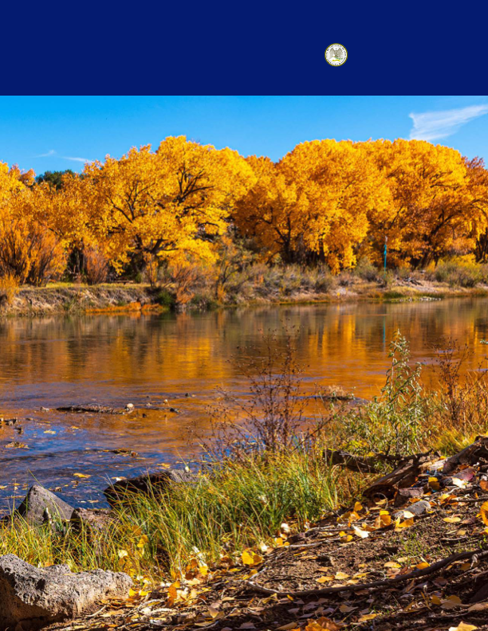
New Mexico Produced Water Reuse and Stewardship Goals and Requirements
50-YEAR
Office of the Governor
MICHELLE LUJAN GRISHAM
WATER ACTION PLAN
2019 Produced Water Act – Section 9D
…”(the WQCC). shall adopt water quality standards for surface and ground waters of the state based on credible scientific data and other evidence appropriate under the Water Quality Act. The standards shall include narrative standards and, as appropriate, the designated uses of the waters and the water quality criteria necessary to protect such uses. The standards shall at a minimum protect the public health or welfare, enhance the quality of water and serve the purposes of the Water Quality Act. In making standards, the commission shall give weight it deems appropriate to all facts and circumstances, including the use and value of the water for water supplies, propagation of fish and wildlife, recreational purposes and agricultural, industrial and other purposes;
8

Slide 9
Public Acceptance of Produced Water Treatment to Conserve Fresh Water
Identify all potential reuse applications that you would support for the use of treated produced water to conserve the use of New Mexico’s freshwater supplies, if the water is treated and regulated to standards that prove it to be safe to use and protect human health and the environment?
Uses inside the oil field - such as construction, drilling and fracking, concrete mixing, and dust suppression (61%)
Industrial uses outside the oil field - such as construction, power generation, manufacturing, etc. (61%)
Agricultural uses, such as irrigation for non-edible crops (e.g., cotton) (65%)
Multiple agricultural uses, e.g., irrigation, rangeland restoration, livestock watering, etc. (53%)
Supplemental drinking water supplies (41%)
I need more information to support the reuse of treated produced water (25%)
No, I would not support the reuse of treated produced water for any use outside of the oil field (5%)
9

Slide 10
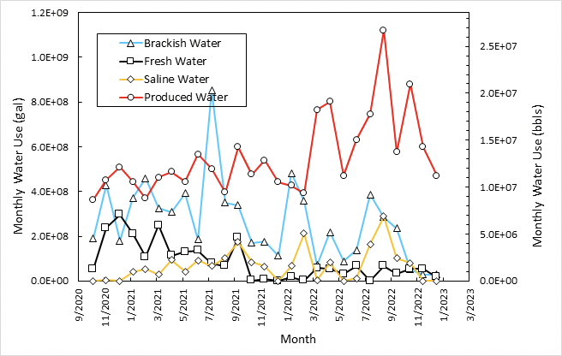
Produced Water Recycling Saves Fresh Water in Oil and Gas Operations
Clean Brines via zwitter ionic, ceramic, composite membranes, or ozone
2020- 50% avg. NM fresh water use in fracking
2023 – 5% avg. NM fresh water use in fracking
10

Slide 11
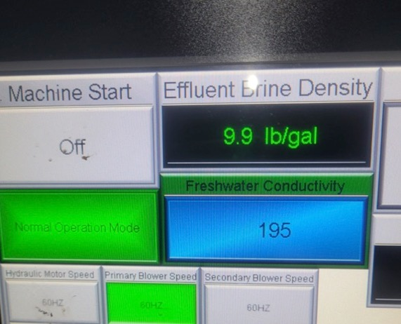
Produced Water Treatment Saves Fresh Water in Oil and Gas Operations
NM OCD – Reuse of treated produced water in plugging and abandoning orphan wells
$2/bbl for fresh water for cementing
$3/bbl for 10# brine
Roswell and Artesia, $25 M+ in federal funding
100-200 bbls/day of treated produced water needed
700 abandoned wells to address
Creates hundreds of data points on treatment quality data
Also creates fresh water for drilling
Permian Produced WaterThermal Treatment
11

Slide 12
Produced Water Treatment Can Create Clean ‘New Water’ at a Reasonable Cost
Constituent | Feed | Distillate
TDS | 126,000 | 350+/-150
TPH | 75+/-70 | 11+/-3
Ammonia | ~400 | 46
Fe | 1 | 0
Mn | 0.36 | 0.004
Na | 38162 | 102
Ca | 4554 | 7
Pb | 0 | 0.006
HCO3 | 120 | 200
SO4 | 270 | 10
Mg | 751 | 1.5
K | 647 | 0.9
Ba | 6.6 | 0.9
Permian Thermal Treatment
12

Slide 13
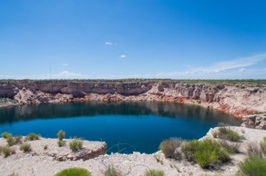
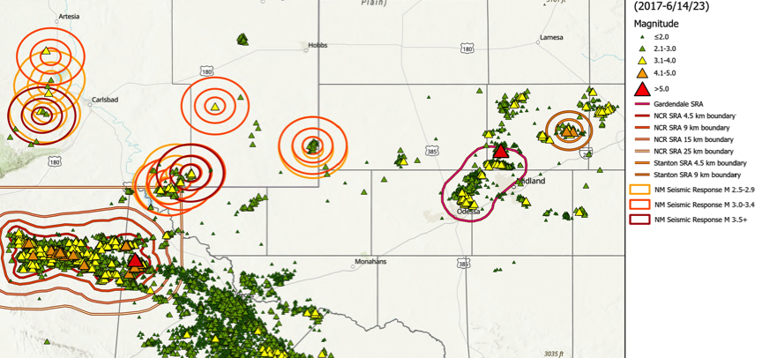
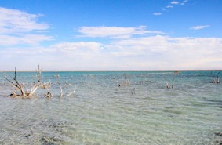
Treatment and Innovation Can Address Other Produced Water Stewardship Challenges
Seismic areas driven by over injection of produced water
Wink Sink #1 and #2
65-acre Lake Boehmer
Possible options:
EPA brownfields – with recycling and reuse
Research test sites for technology evaluation for recycling and reuse
Requires industry interest and support
San Juan
Basin
13

