Slide 1
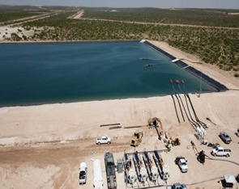
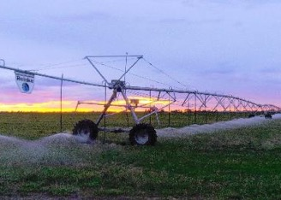
Produced Water Stewardship and Environmental Stewardship
A Changing Landscape
Groundwater Protection council
UIC Conference
February 26-28, 2024 – oklahoma city
Mike Hightower, Director mmhightower@q.com
Jerri Pohl, NM State Engineers Office
Jerri.Pohl@OSE.nm.gov

Slide 2
Presentation Overview
Review of EPA’s National Water Reuse Action Plan efforts for produced water stewardship and reuse.
What “is not” produced water and environmental stewardship.
What “ is” produced water and environmental stewardship and why does it matter.
Opportunities for GWPC/EPA UIC to have a major role in oil and gas environmental and produced water stewardship and regional economic development.
2

Slide 3
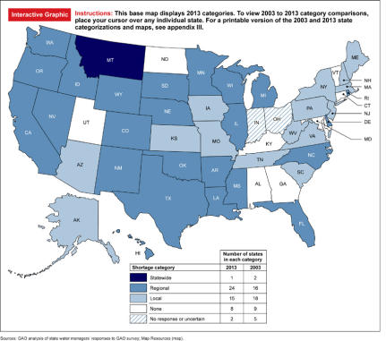
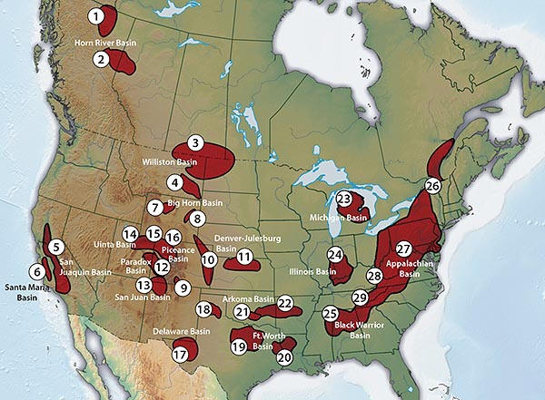
Why Consider Treating and Reusing Produced Water
State Water Stress
Unconventional Oil and Gas Basins
3

Slide 4
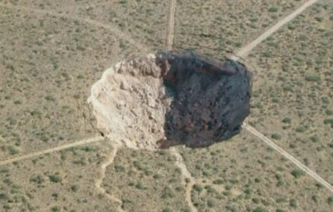
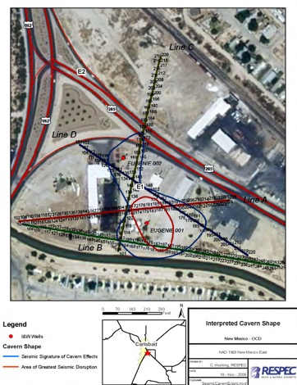
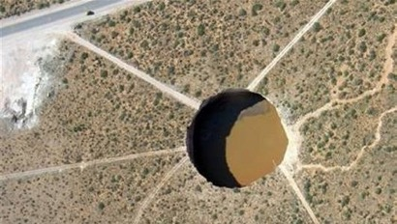
Carlsbad Brine Well – Using Fresh water to make brine for Drilling
The Carlsbad Brine Well, located at 3005 South Canal Street in Carlsbad, New Mexico, was used to produce brine water for oil and gas drilling from 1978 to 2008. Brine is a salty water that is used in drilling mud and is naturally occurring nonpotable water.
4

Slide 5
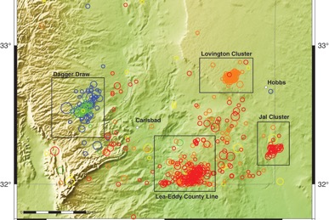
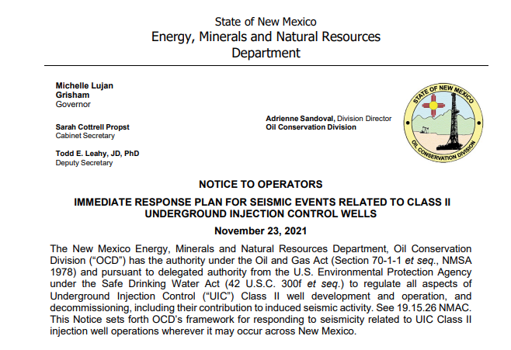
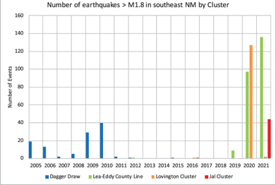
Over Injection of Produced Water Induces Seismic Activity in O&G Regions in NM
Obviously we need better produced water stewardship in NM
5

Slide 6
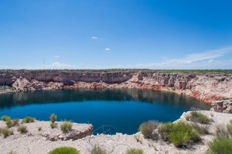
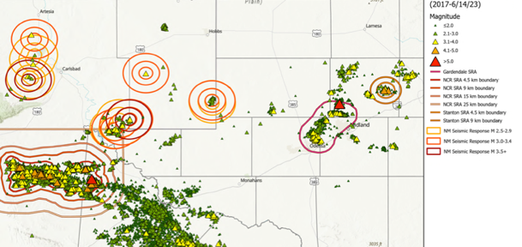
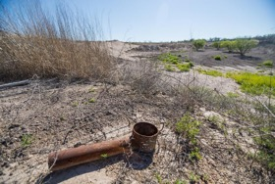
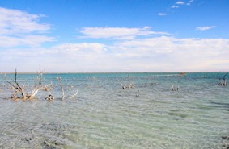
Lack of Produced Water/Environmental Stewardship In TX Too
Shallow Disposal – Ecological Impacts
Holladay Hole
Wink Sink #2
65-acre Lake Boehmer
’Texas Dead Sea’
Deep Disposal - Earthquakes
6

Slide 7
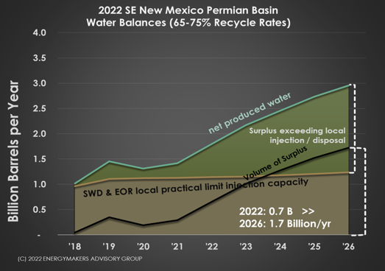
Alternative to Disposal is Needed in NM Permian Basin
At 2018 production, OCD estimated New Mexico had 10 years of disposal
Production has doubled since 2018- oil and gas provides 50% of state revenue
200,000 acft/yr of PW
7

Slide 8
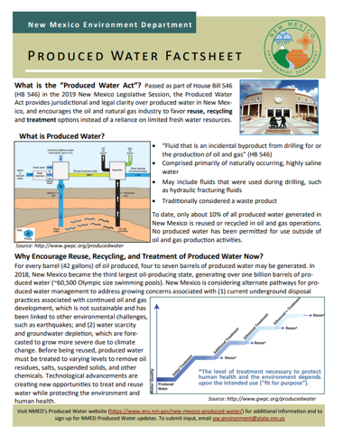
2019 New Mexico Produced Water Act –Driving Stewardship
What is the 2019 “Produced Water Act”?
Passed as part of House Bill 546 (HB 546) in the 2019 New Mexico Legislative Session,
Provides jurisdictional and legal clarity over produced water management and ownership in New Mexico, and
Encourages the oil and natural gas industry to favor reuse, recycling and treatment options instead of a reliance on limited fresh water resources for drilling and fracking and deep well injection.
8

Slide 9
2020 EPA National Water Reuse Action Plan
Focus on the fit-for-purpose treatment and reuse of waste water
Five major programmatic areas:
  Thermo-electric cooling water
  Agricultural waste water
  Municipal waste water
  Produced water
  Storm water
Produced water milestones in Section 2.4.2 of the WRAP include collaboration and outreach with WRA and industry
Two of the United Nations’ Sustainable Development Goals are water reuse as key to a more sustainable future.
9

Slide 10
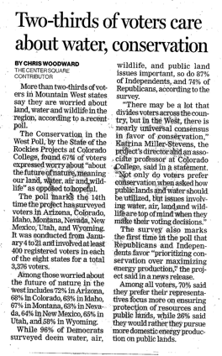
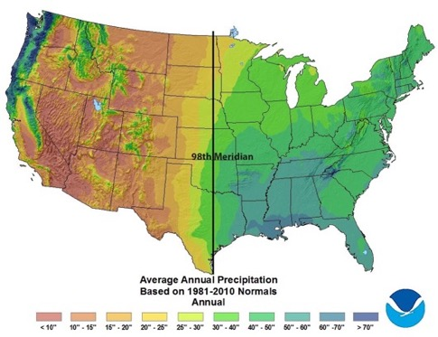
States with Produced Water Recycling and Reuse Efforts
Reuse – use outside oil and gas
Recycling – use inside oil and gas,
States
  California
  Pennsylvania
  Wyoming
  New Mexico
  Arizona
  Texas
  Colorado
  Oklahoma
  Utah
Significant Environmental, Social, and Economic Stewardship Benefits
10

Slide 11
Water Supply Growth Drives Economic Growth
NM is 49th in fresh water availability
AZ NM
Water supply: 7 M acft/yr 2 M acft/yr
GDP: $300 B/yr $100 B/yr
Ag use: ~72% ~75%
M&I use: ~28% ~25%
Population: 7 M 2 M
“Water promises to be to the 21st century what oil was to the 20th century: the precious commodity that determines the wealth of nations.”
Fortune Magazine, May 15, 2000
US GDP Growth vs Energy and Water Growth
11

Slide 12
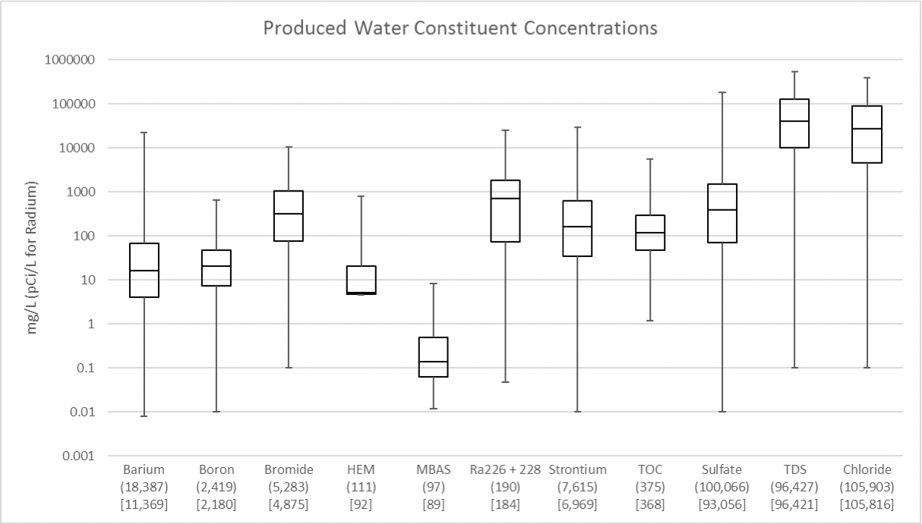
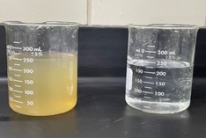
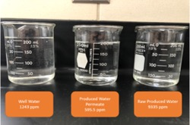
Produced Water Treatment Needed for Recycling and Reuse
Permian Basin
Permian Basin
[EPA-821-S19-001]
San Juan Basin
12

Slide 13
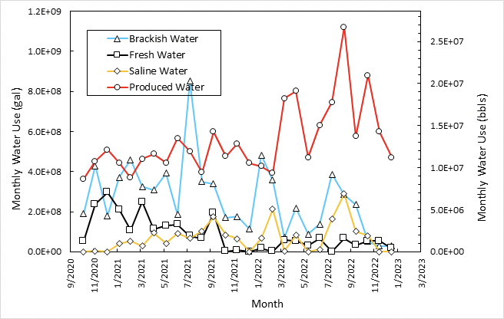
Affect of Produced Water Recycling Regulations on Fresh Water Use
Current Water Use in
Drilling and Fracking
State | Fresh Water Use | Produced Water Reuse
New* Mexico | 5% | 80%
Texas | 50% | 50%
* Fresh water use regulation
change in 2019, more restrictions
proposed in 2024
13

Slide 14
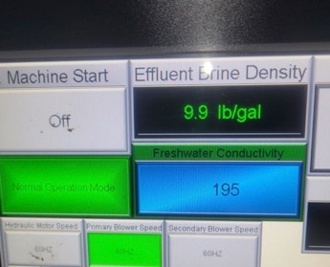
Produced Water Treatment for Recycling in Oil and Gas
More recycling inside oil and gas
  Treatment and reuse of produced water in plugging and abandoning orphan wells
  Similar use in repurposing abandoned oil and gas wells for brackish water wells
  Get more oil recovery and lower SWD operational costs with ‘clean brine’
Brine
Recovery
Distillate
NMPWRC Thermal Technology Testing
PW
Produced water thermal treatment - fresh water for cementing and 10# brine for re-drilling before cementing
$2/bbl for fresh water and $3/bbl for 10# brine
$25 M in federal funding
Clean
brine
14

Slide 15
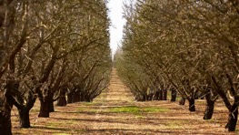
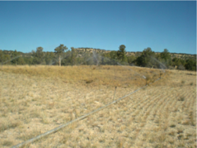
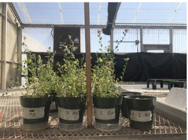
Western States Treated Produced Water Reuse for
Land and Agriculture in TX, CA, and WY
State | TDS mg/L | Total Constituents Evaluated | Date Developed | Application
California* | 1000 | ~100 | 1995 | Full-scale irrigation
Wyoming | 500 | ~100 | 2020 | Full-scale rangeland
Texas RRC | 1000 | ~50 | 2024 | Pilot-scale rangeland or irrigation
* Conventional produced water only
15

Slide 16
GWPC Opportunities to Support Improved Produced Water and Environmental Stewardship
Establish Water Star as the Produced Water Data Information Platform
  Both water quantity and quality (~15 major constituents per EPA report)
  Some aggregation by ¼ township or equivalent lat/long
Consider improvements to FracFocus
  Require MSDS information for ‘proprietary chemicals’
  Consider working with industry to endorsing ACS “Green Fracking” like-approach
Consider weighing-in on establishing standards for repurposing plugged and abandoned wells and the associated re-drilling, re-plugging, and re-perforating to access shallow or deep brackish and saline aquifers for use for potential agricultural or industrial applications.
16

